Slide 1
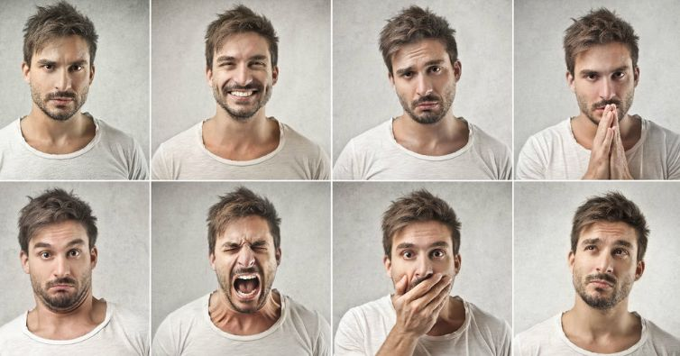
Development of ML models to predict client emotions based on facial expressions and audio input in various online meeting platforms.
Group Members
Harsh Trivedi - 0788765
Kunal Ghaware - 0769182
Panav Jadhav - 0774109
Kavita Virk - 0787818

Slide 2


Slide 3
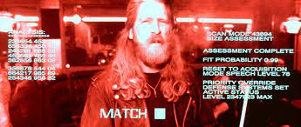

Slide 4
Introduction
Reasons that motivated us for doing this study
New Field of exploration.
Solving Real-World Problem.
What was the problem
Therapist should get an overview of the session that they had with the client and verify weather or not they are reading the clients emotions correctly.

Slide 5
Background
Existing audio and video model (Alpha Model).
VGG16 for Video Emotion Classification Model.
Training Accuracy – 94.45%
Test Accuracy – 63.61%
Dataset size – 7254 images (JPEG)
LSTM for Audio Emotion Classification Model.
Training Accuracy – 96.62%
Test Accuracy – 76.82%
Dataset size – 2446 audio files (WAV)
Web Application

Slide 6
Research Objectives
Predicting emotions of the client from facial expressions and speech input.
Deploy the model on the Web Page of an existing website using API to support end to end analysis.

Slide 7
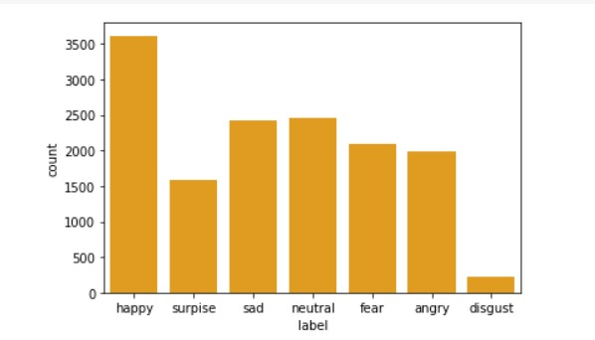
Data Description
FER – 2013 (Kaggle)
48 x 48 pixel images
14236 training images
7632 testing images
Grayscale images
Dataset is already divided into 7 categories.
Angry
Disgust
Fear
Happy
Sad
Surprise
Neutral

Slide 8







Data Description
Angry
Disgust
Fear
Happy
Neutral
Sad
Surprise

Slide 9
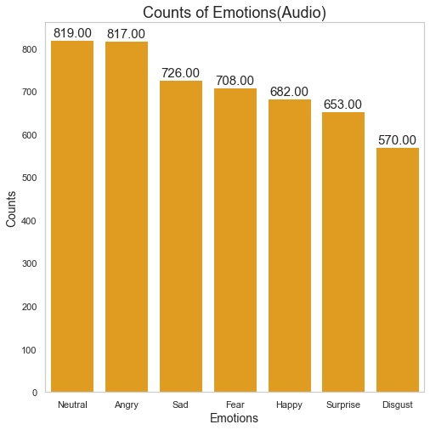
Data Description
Multilingual Dataset (English, Arabic, Urdu, Italian, German)
WAV Format
3976 training audio files
996 testing audio files
Dataset is already divided into 7 categories.
Angry
Disgust
Fear
Happy
Sad
Pleasant Surprise
Neutral

Slide 10

Data Description
Angry
Happy
Sad

Slide 11
Methods (Pipeline)
Analyzing and studying the alpha version model and results
Deploying the model API on the WebPage
Finding out scope of improvement of the model finalized in alpha version
Creating API to deploy the trained models on the website
Gathering dataset required for training our model
Saving the models that we have trained
Running different models to see which model fits the best for our problem statement
Finalizing the best model that meets our problem statement

Slide 12
Results
Models tested for Video – MobileNet, VGG16, AlexNet, CNN, VGG16 using ImageNet
Model tested for Audio – LSTM and CNN
Models tested | Accuracy
MobileNet | 67.01
AlexNet | 52.91
VGG16 | 61.43
CNN | 43.91
VGG16 using ImageNet | 76.34
Models tested | Accuracy
LSTM | 45.00
CNN | 81.91

Slide 13
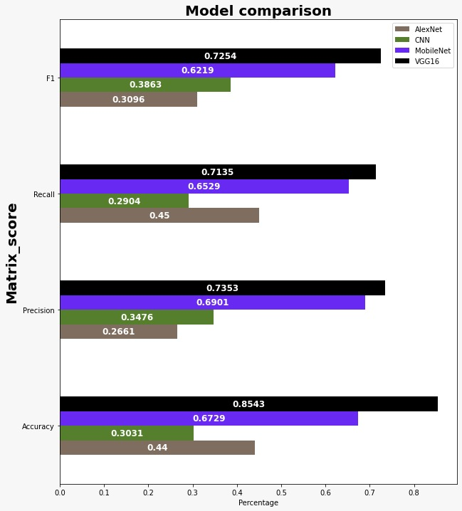
Results(Video Model)

Slide 14
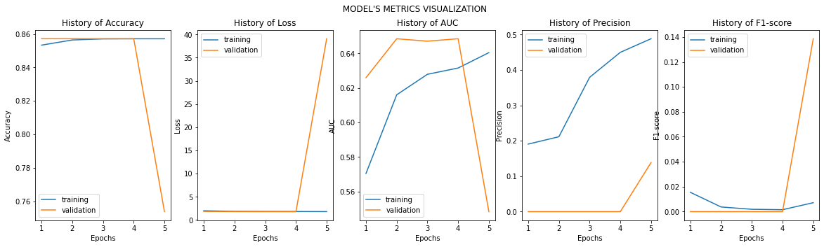
Results (Video Model)
Accuracy – 85.71%
Precision – 73.53%
Recall – 71.63%
F1 Score – 81.94%
AUC – 57.87%

Slide 15
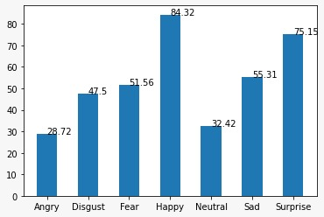
Results (Video Model)
Angry – 28.72%
Disgust – 47.50%
Fear – 51.56%
Happy – 84.32%
Neutral – 32.42%
Sad – 55.31%
Surprise – 75.15S%

Slide 16
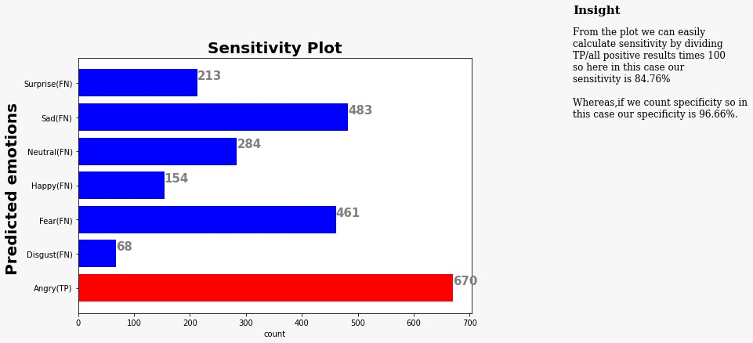
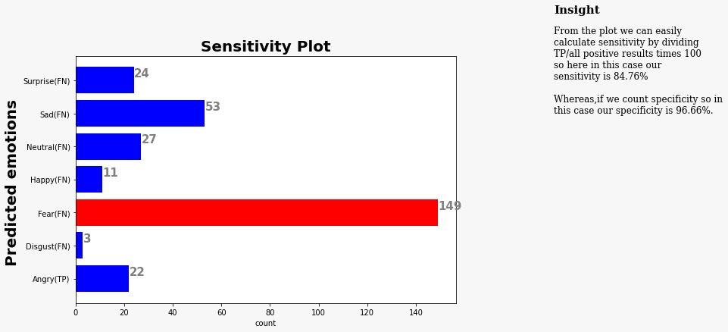
Sensitivity of the video model
Angry Emotion
Disgust Emotion

Slide 17
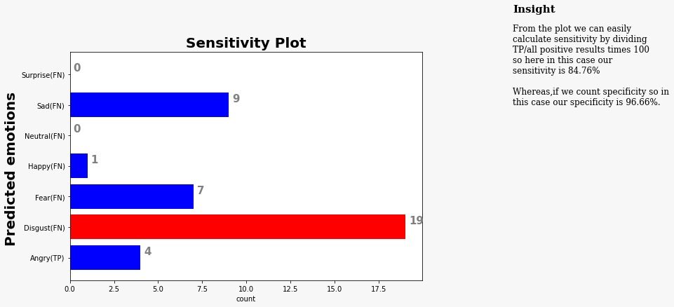
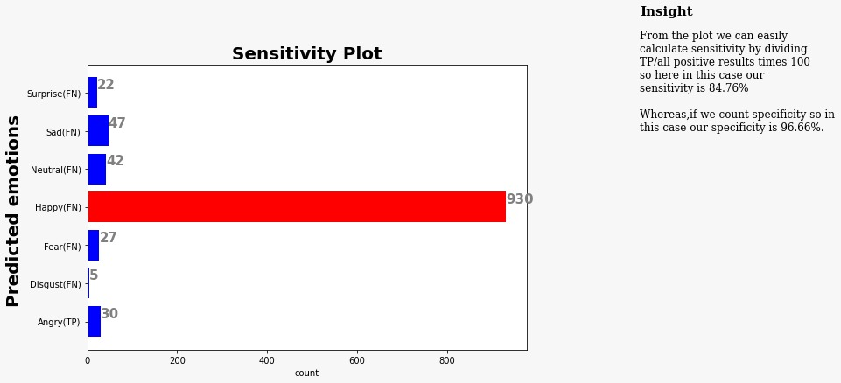
Sensitivity of the video model
Fear Emotion
Happy Emotion

Slide 18
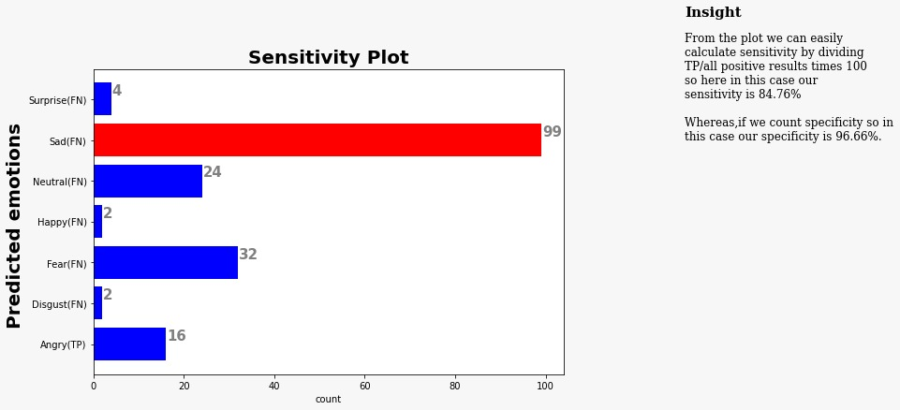
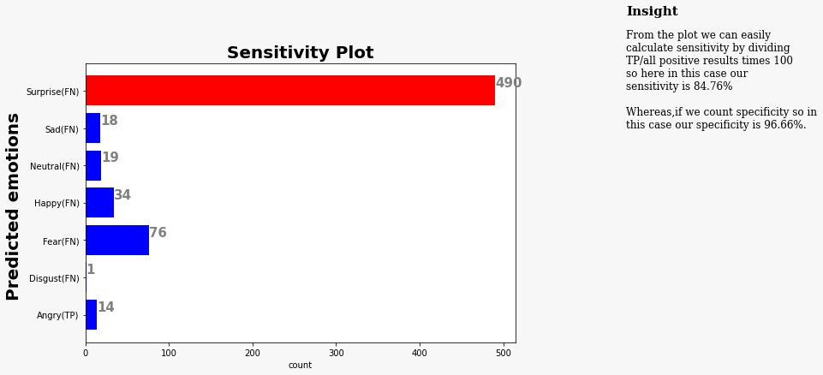
Sensitivity of the video model
Sad Emotion
Surprise Emotion

Slide 19
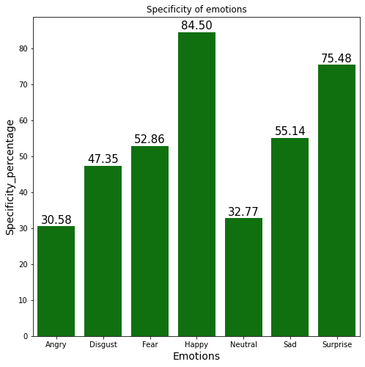
Specificity of Video model

Slide 20
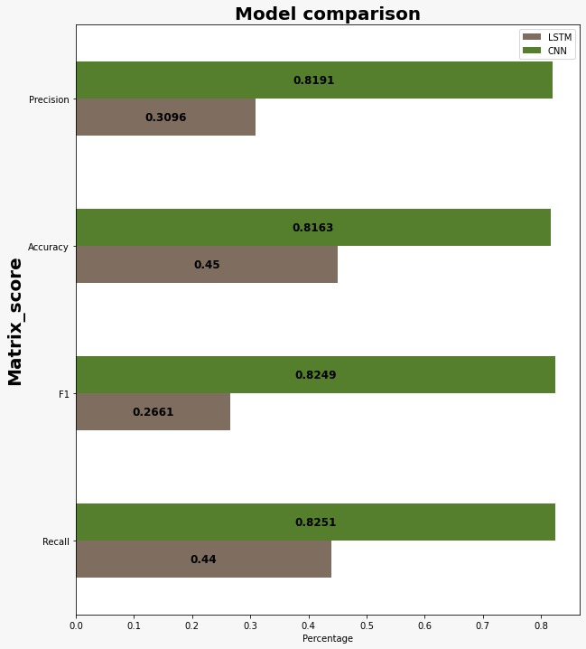
Results(Audio Model)

Slide 21
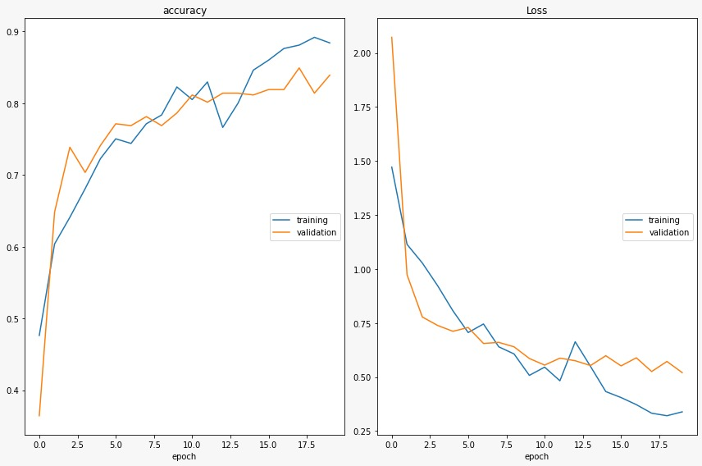
Results (Audio Model)
Accuracy – 81.91%
Precision – 81.63%
Recall – 82.51%
F1 Score – 82.49%
AUC – 81.08%

Slide 22
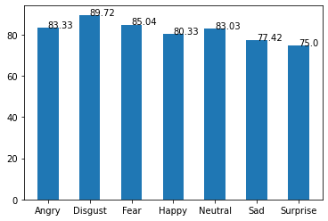
Results (Audio Model – Accuracy Chart w.r.t. every class)
Angry – 83.33%
Disgust – 89.72%
Fear – 85.04%
Happy – 80.33%
Neutral – 83.03%
Sad – 77.42%
Surprise – 75.00%

Slide 23
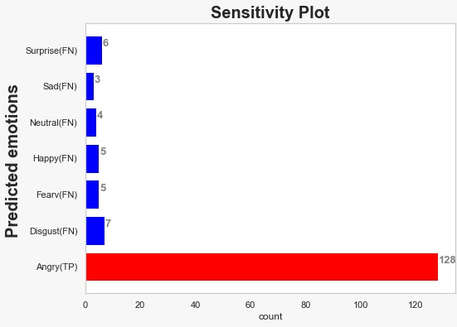
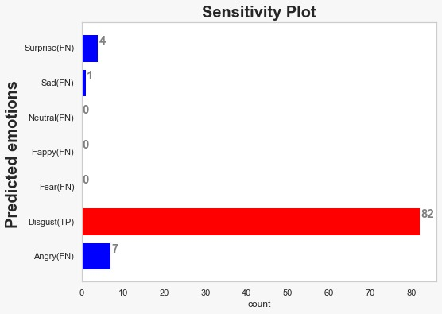
Sensitivity of the audio model
Angry Emotion – 81.01 %
Disgust Emotion – 87.23 %

Slide 24
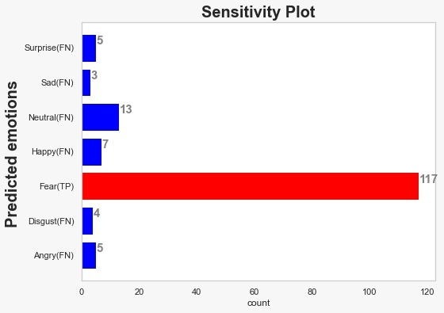
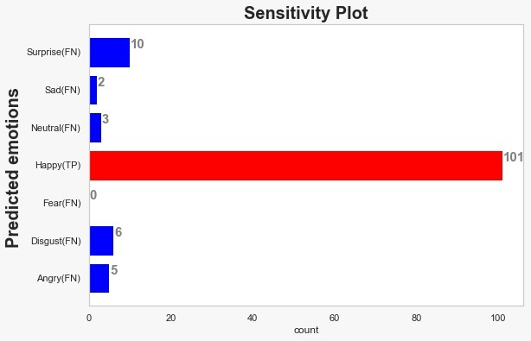
Sensitivity of the audio model
Fear Emotion – 75.97 %
Happy Emotion – 79.52 %

Slide 25
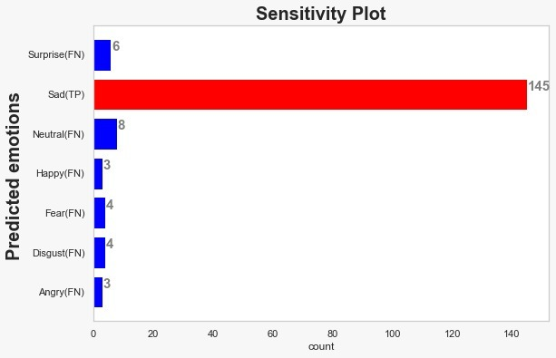
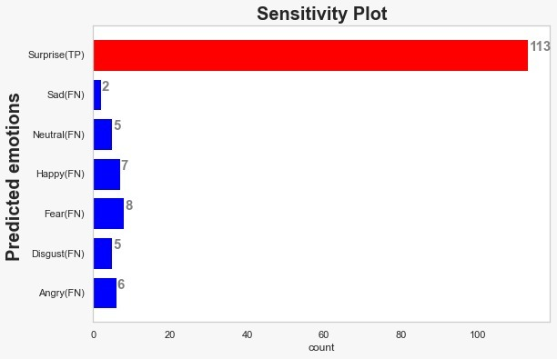
Sensitivity of the audio model
Sad Emotion – 83.81 %
Surprise Emotion – 77.39 %

Slide 26
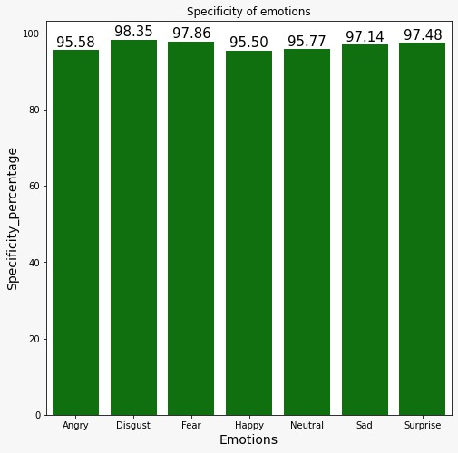
Specificity of Audio model

Slide 27
Results (API)
Built Restful API using Flask
Called both the models in the same API and performed emotion prediction on both the Facial Expressions and Voice Input.
Deploying the API on CogniXR’s Website.

Slide 28
Conclusions
In past few week, we have analyzed alpha models and made some changes to the alpha models so that we can get better accuracy than their model.
We have then changed working of the audio model from just predicting emotion from English language to predicting emotions from Multiple languages (Arabic, Urdu, English, German, Italian).
We have then created a API to deployed the models that we have trained on the Webpage that can be then used by CogniXR.

Slide 29
Future work
Live therapy session prediction.
Collecting more multilingual audio data and training the audio model on the same.

Slide 30
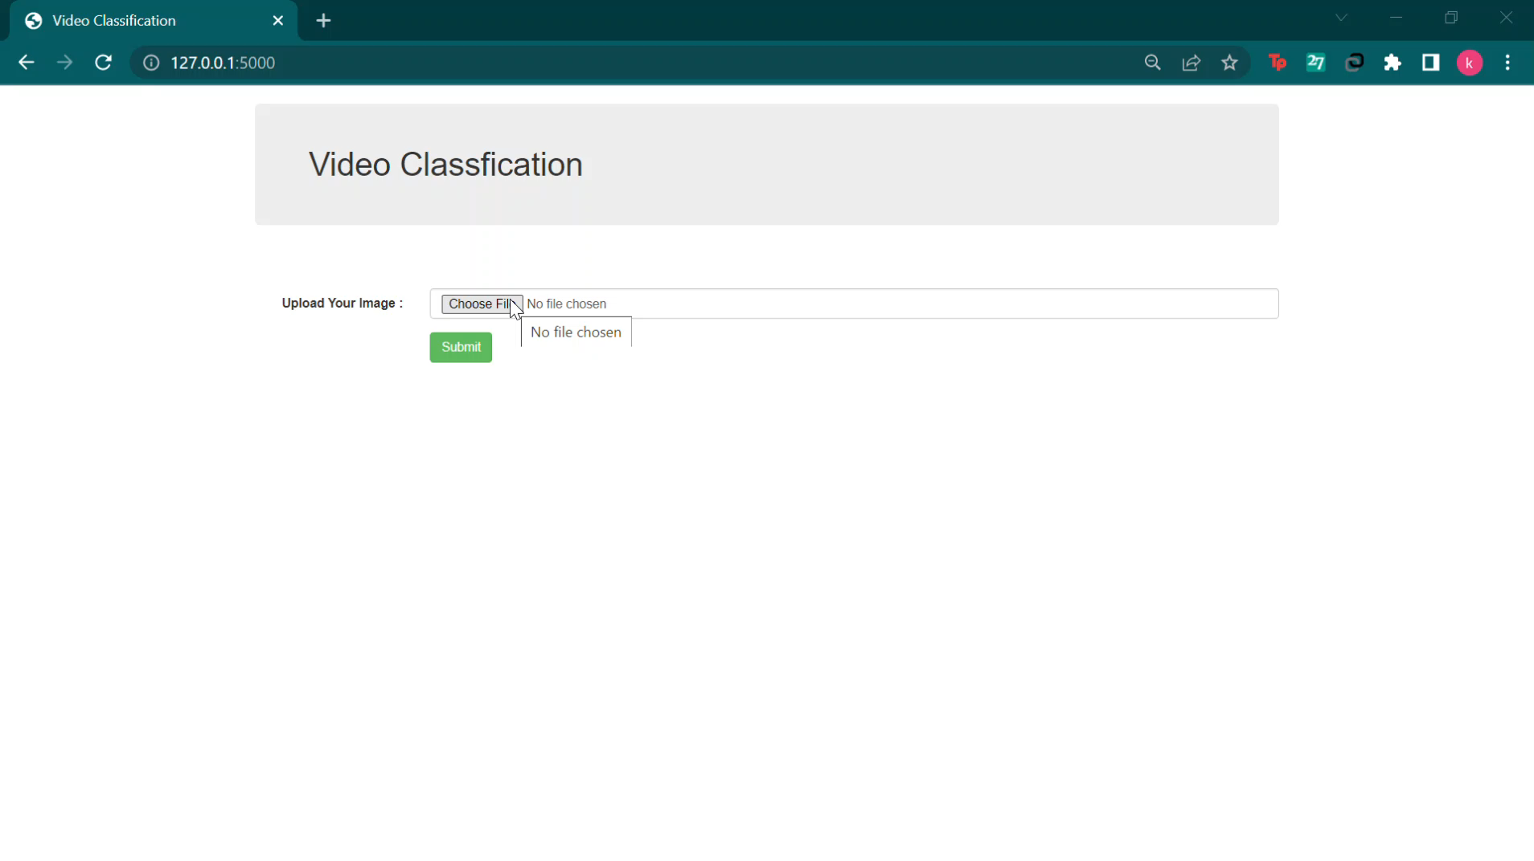
Demo

Slide 31
THANK YOU
ANY QUESTIONS?

